Slide 1
Are You Likely to Graduate?
Natalia Walls, Ruben Valdovinos, Jacob Brandis

Slide 2
About the Data
School data from 2020-2021 from National Center for Education Statistics
Each row represents a school in the United States, and US territories
Data originally has 6054 rows and 61 columns
Columns we focused on:
Total Graduated
Total Men
Total Women
Total Black, White, Asian, Hispanic, Nonresident Alien
School Name
Major of Graduates

Slide 3
Areas that we looked into
Where are the schools located
Percent of graduates by state representation
Comparison of ethnicities in different areas
Comparison of genders in different areas
Comparison of genders in different fields of study

Slide 4
Cleaning up the data
Hard to read columns were renamed to represent readable descriptions
Merged two datasets, where the IDs matched to display school name
Dropped columns that were not useful (i.e. Reported or not)
Focused on specific races: White, Hispanic, Black, Asian, Nonresident Alien

Slide 5
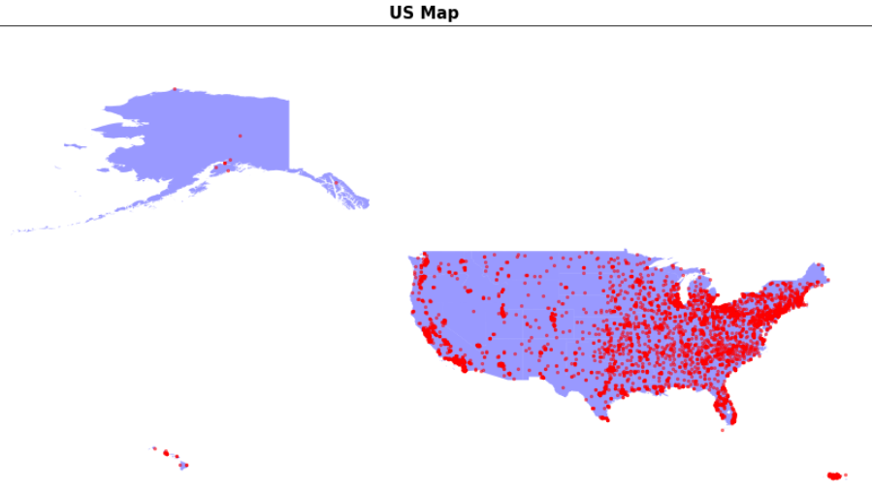
Where are the schools?

Slide 6
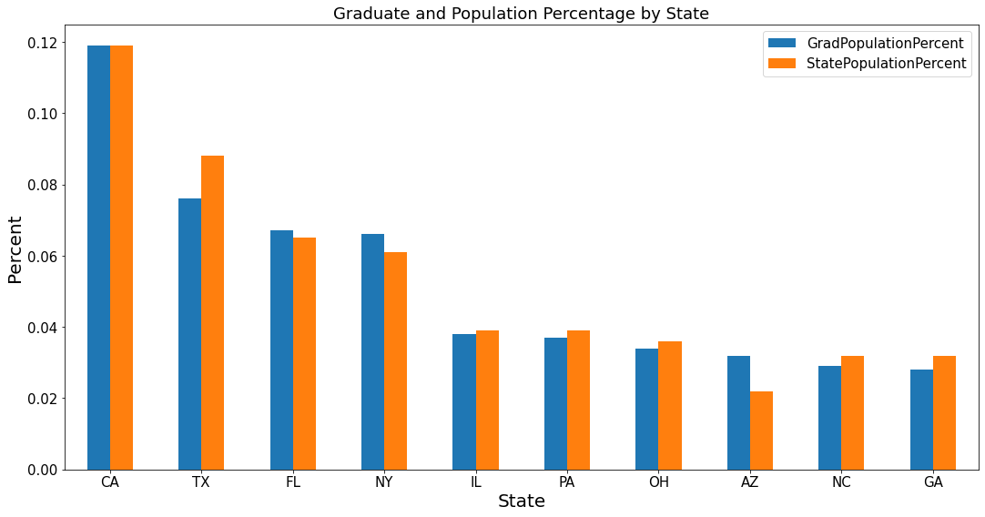
Top States by Graduate and Population Percent

Slide 7
Top States by Student Graduate and Population Percent Cont.
Top ten States by Student Graduates percent are almost the same as the top populated states
However, some of the top states graduates are not 100% proportional to population (~2-3 percent)

Slide 8
Do the most populated states have the most graduates because of their population?

Slide 9
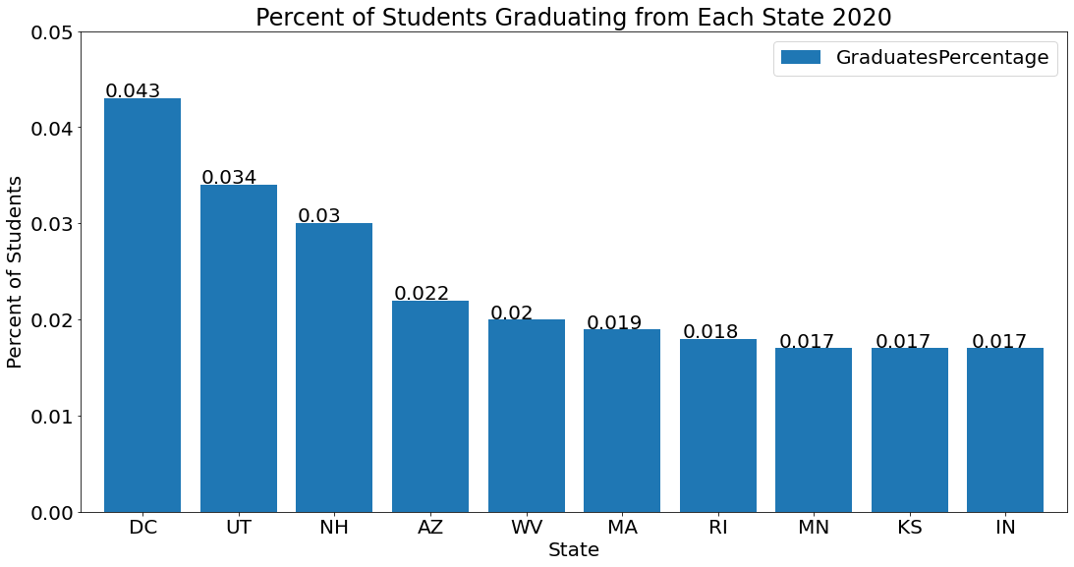
States With Highest Density of 2020 Graduates

Slide 10
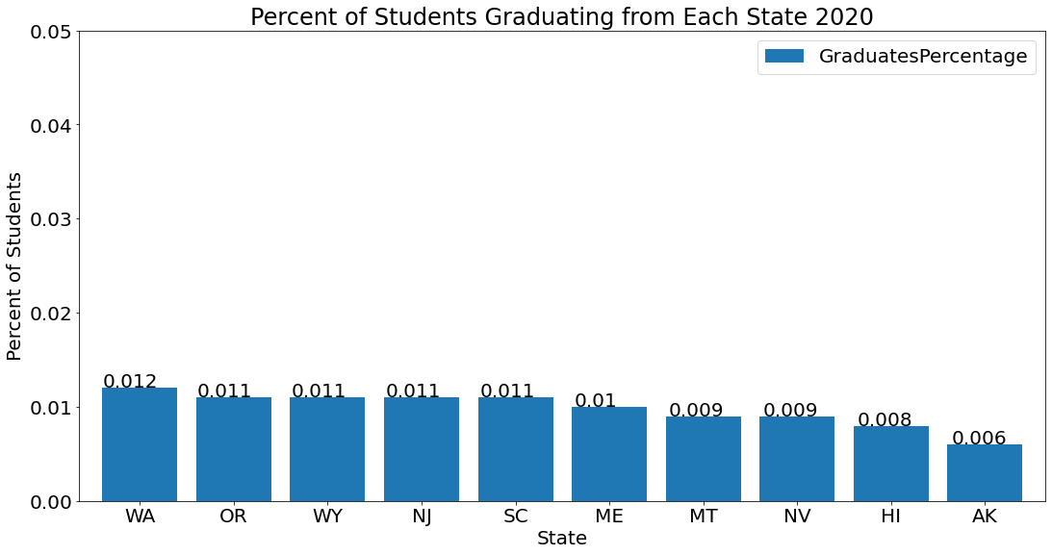
States With Lowest Density of 2020 Graduates

Slide 11
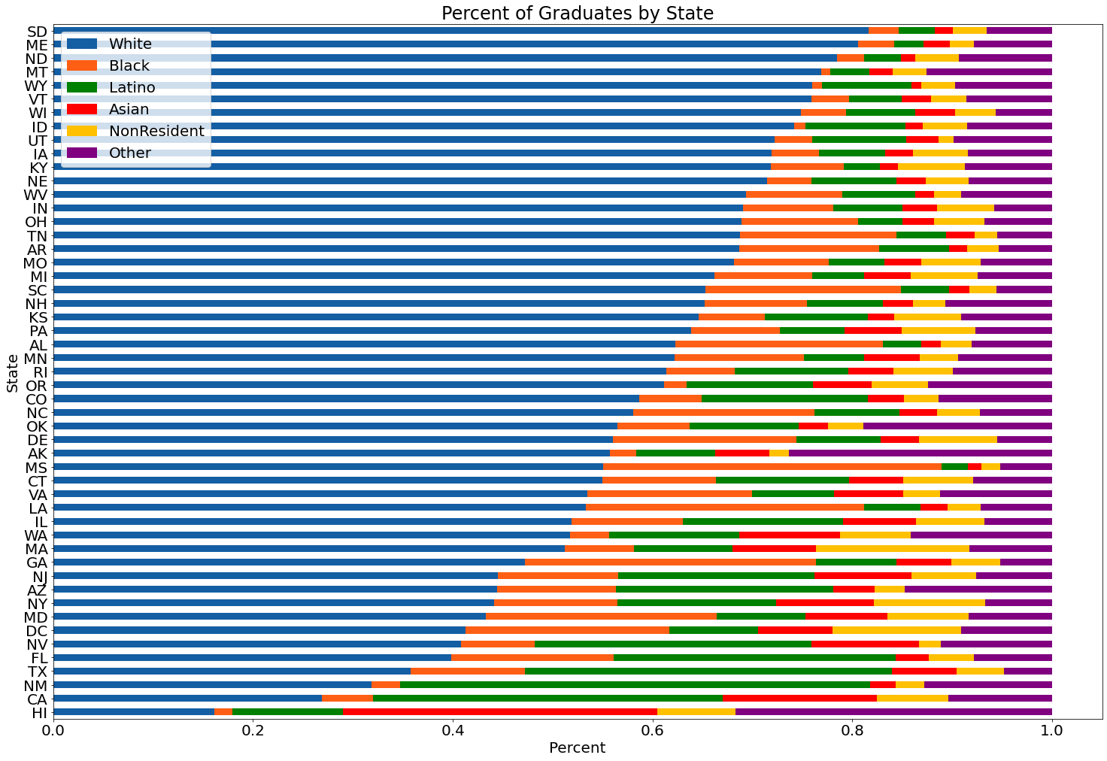

Slide 12
Does gender play a role?

Slide 13
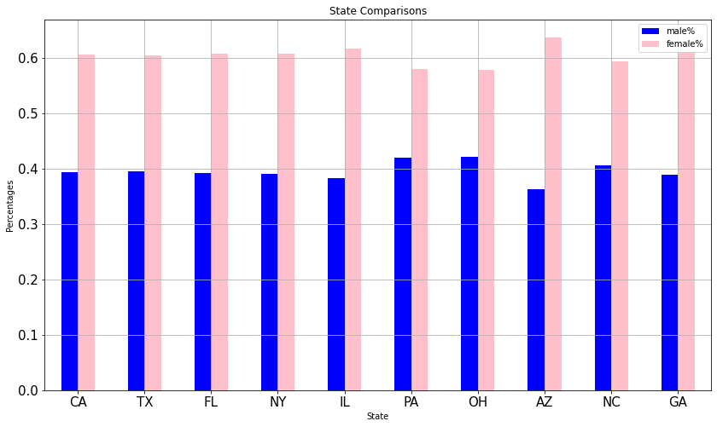
Men vs. Women
.

Slide 14
Men vs. Women continued
Male and female never reach 50/50 percent in any states
The closest state is West Virginia with 52 % of the graduates being women
at least 65% of graduates are women in 48 states

Slide 15
All Men and All Women Schools
304 all women schools with 12753 graduates
Many of these schools were beauty schools, salon schools, cosmetology schools, and health and nursing schools
141 all men schools with 5682 graduates
Many of these schools were technical schools, barber schools, and priest/rabbi schools

Slide 16
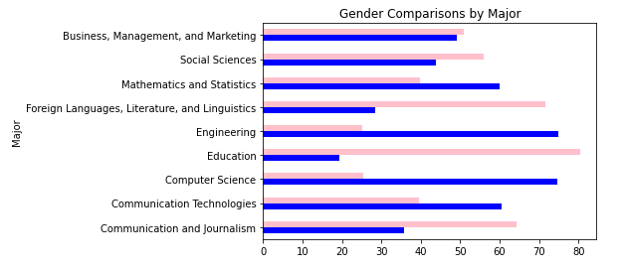
Gender Comparison Graduated by Majors

Slide 17
Conclusion
On average, more white people have a higher graduation rate in most states
Typically more women graduate than men
Gender does not play a role in graduation rates in different states
Gender does play a role in graduation rates in different majors
Social sciences, communications, and languages are more female dominated
STEM majors are more male dominated
Business is even across the board

Slide 18
THANK YOU!

Slide 19
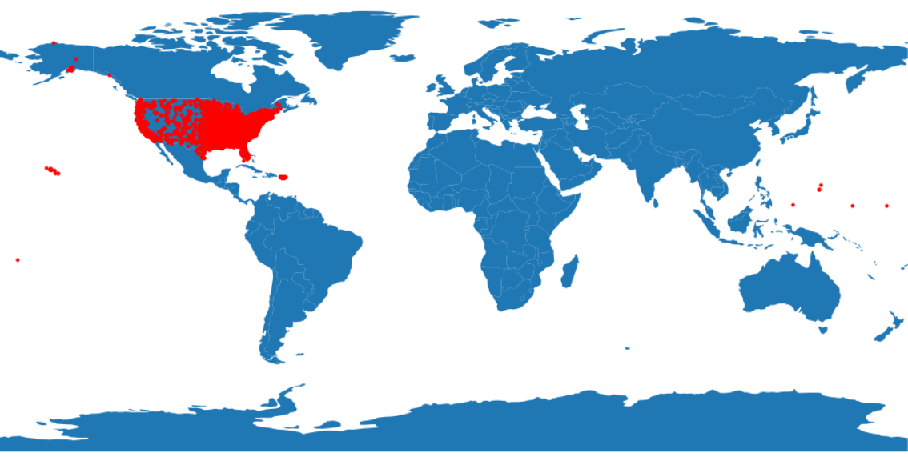
World map

Slide 20
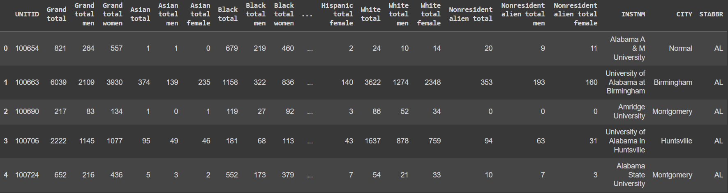
What data looks like

Slide 21
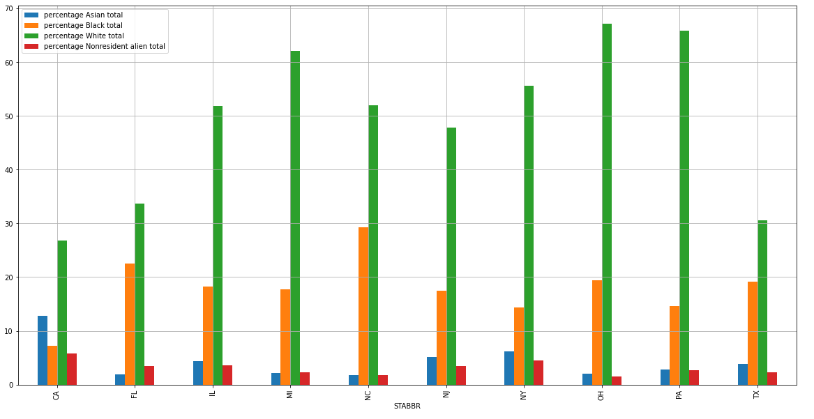
Average Percent of Students that
Graduate by State and Race

